Slide 1



CIPA Visit to ASPA
5 October 2016
Clare Cornell
Member of the International Liaison Committee
IN ASSOCIATION WITH

Slide 2
Three Dimensional Trade Marks
Topics for Discussion
Legal Requirements
Inherent Distinctiveness
Acquired Distinctive Character
Case Law
Registered or Not?

Slide 3
Statistics!
At 29 September 2016
8786 Applications for 3D marks have been filed at the EUIPO
1696 have been refused
4312 have been registered
103 have been registered based on acquired distinctive character

Slide 4
EU Trade Mark Directive
Article 3 - Signs of which a trade mark may consist
A trade mark may consist of any signs, in particular words, including personal names, or designs, letters, numerals, colours, the shape of goods or of the packaging of goods, or sounds, provided that such signs are capable of:
(a) distinguishing the goods or services of one undertaking from those of other undertakings; and
(b) being represented on the register in a manner which enables the competent authorities and the public to determine the clear and precise subject matter of the protection afforded to its proprietor.
* (EU) 2015/2436 of 23/12/2015 – This wording will be added into EU regulations 1 October 2017

Slide 5
EUTMR – European Union trade mark Regulation
Article 4 - Signs of which an EU trade mark may consist
An EU trade mark may consist of any signs capable of being represented graphically, particularly words, including personal names, designs, letters, numerals, the shape of goods or of their packaging, provided that such signs are capable of distinguishing the goods or services of one undertaking from those of other undertakings.

Slide 6
EU Trade Mark Directive
Article 4 - Absolute grounds for refusal or invalidity
(e) signs which consist exclusively of:
  (i) the shape, or another characteristic, which results from the nature of the goods themselves;
  (ii) the shape, or another characteristic, of goods which is necessary to obtain a technical result;
  (iii) the shape, or another characteristic, which gives substantial value to the goods;
  Rationale behind these grounds is to prevent indefinite protection being afforded for functional and technical results

Slide 7
Filing Requirements
A three-dimensional mark is a mark consisting of a three-dimensional shape (including containers, packaging and the product itself).
Application may consist of up to six perspectives of the same shape that must be submitted in one single JPEG.
Applicants applying for registration of a three-dimensional mark must make a corresponding indication in the application.

Slide 8
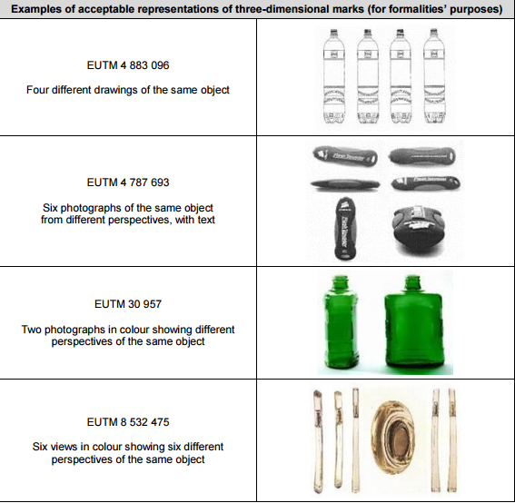
EUIPO Examples of acceptable representations

Slide 9
Guidelines for Examination
Three-dimensional trade marks can be grouped into three categories:
  Shapes unrelated to the goods and services themselves
    Usually distinctive.
  Shapes that consist of the shape of the goods themselves or part of the goods or shapes related to the goods or services
    Distinctiveness must be checked.
    Is it so materially different from basic, common or expected shapes that it enables a consumer to identify the goods just by the shape of the packaging or container?
    If not, must prove acquired distinctiveness.

Slide 10
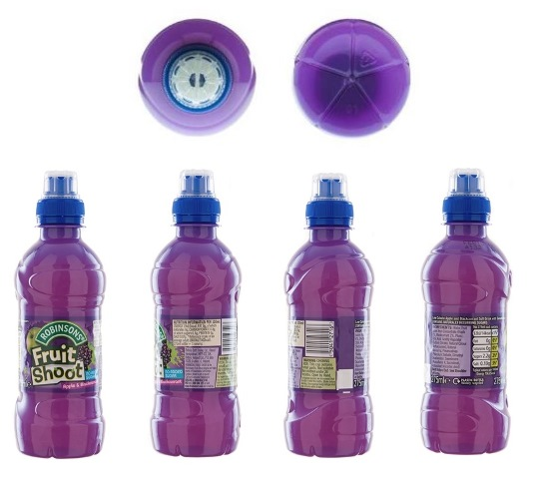
  Shape of the packaging
    The shape applied for must be materially different from a combination of basic or common elements and must be striking.
Robinsons Soft Drinks Limited
Colour: Purple; Dark Purple; Light Purple; Green; Shades Of Green; White; Blue; black; cream.

Slide 11
Inherent Distinctiveness
Only a mark that departs significantly from the norms or customs of the sector, and fulfils its essential function of indicating origin, is not devoid of distinctive character.
The average consumer is not in the habit of making assumptions as to the origin of goods on the basis of their shape or the shape of packaging in the absence of any word or graphic element.

Slide 12
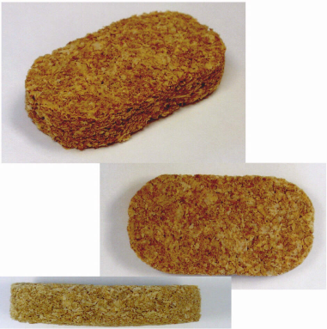
Acquired Distinctive Character
If the objection exists throughout the European Union, as is normally the case for 3D marks, acquired distinctiveness must be proven throughout the entire European Union.
Distinctiveness
  Requires at least a significant proportion of the relevant public, by virtue of the mark, identifying the goods or services as originating from a particular undertaking.
  The mark must have become distinctive through use before the application for registration is filed.
Acquired Distinctiveness
Weetabix Limited
30 Cereal preparations for food for human consumption, all in the form of biscuits.

Slide 13
Assessment of distinctiveness takes into account factors such as:
  the market share held by the mark;
  how intensive, geographically widespread and long-standing use of the mark has been;
  the significance of the investments by the undertaking to promote it;
  the proportion of the relevant class of persons who, because of the mark, identify the goods as originating from a particular undertaking
  statements from chambers of commerce and industry or other trade and professional associations.
If, on the basis of those factors, at least a significant proportion of the relevant class of persons identifies goods as originating from a particular undertaking because of the mark, then it is capable of registration.

Slide 14
Examples of evidence to prove acquired distinctive character:
catalogues, sales brochures
price lists, invoices
annual reports, turnover figures
advertising investment figures and reports
advertisements (press cuttings, billboard posters, TV adverts) together with evidence of their intensity and reach
customer and/or market surveys
affidavits

Slide 15
Recent Cases
Société Des Produits Nestlé SA - and - Cadbury UK Ltd
The London Taxi Corporation Limited - and - (1) Frazer-Nash Research Limited (2) Ecotive Limited
Coca Cola Corporation v EUIPO
Yoshida Metal Industry Co. Ltd v EUIPO

Slide 16
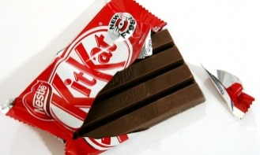
Société Des Produits Nestlé SA - and - Cadbury UK Ltd
Nestlé applied to register the 3D shape of the KitKat bar in July 2010
Application was examined and accepted as a “trade mark” i.e. any sign capable of being represented graphically which is capable of distinguishing goods or services of one undertaking from those of other undertakings

Slide 17
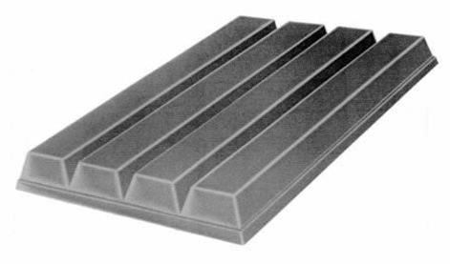
The trade mark corresponds to the shape of a 4 finger KitKat bar.
GB 2552692 Filed 8th July 2010
Class 30
Chocolate; chocolate confectionery; chocolate products; confectionery; chocolate-based preparations; bakery goods; pastries; biscuits; biscuits having a chocolate coating; chocolate coated wafer biscuits; cakes; cookies; wafers.
Notes:
The Trade Mark corresponds to the shape of Nestlé’s four-finger KIT KAT product except that it lacks the KIT KAT logo embossed onto each of the fingers of the actual product:

Slide 18
Application was opposed by Cadbury UK on various grounds including:-
S 3(1)(b) - The following shall not be registered – trade marks which are devoid of any distinctive character,
3(2)(a) & (b) - A sign shall not be registered as a trade mark if it consists exclusively of –
(a) the shape which results from the nature of the goods themselves,
(b) the shape of goods which is necessary to obtain a technical result,

Slide 19
On 20 June 2013, the UK Registrar of Trade Marks held that:
The trade mark was devoid of inherent distinctive character.
Registration was precluded because the trade mark consisted exclusively of the shape which was necessary to obtain a technical result.
  Except in relation to cakes and pastries.

Slide 20
The examiner found that the shape in respect of which registration was sought had three features:
The basic rectangular slab shape,
  (A shape which results from the nature of the goods themselves).
The presence, position, and depth of the grooves running along the length of the bar, and
  (Necessary to obtain a technical result).
The number of grooves, which, together with the width of the bar, determine the number of ‘fingers’
  (Necessary to obtain a technical result).

Slide 21
Appeal - Questions referred to the CJEU
How must acquired distinctive character be proven;
  by recognition of the mark and identifying origin of the goods?
  by reliance on the mark to identify the origin of the goods?
If the shape has three features, one as a result of the nature of the product and two which obtain a technical result, is registration precluded?
Does the preclusion of registration of shapes necessary to obtain a technical result apply to the manner in which the goods are manufactured and/or the manner in which the goods function?
These questions have been paraphrased
Notes:
Question 1
“In order to establish that a trade mark has acquired distinctive character following the use that had been made of it within the meaning of Article 3(3) of Directive 2008/95 ..., is it sufficient for the applicant for registration to prove that at the relevant date a significant proportion of the relevant class of persons recognise the mark and associate it with the applicant’s goods in the sense that, if they were to consider who marketed goods bearing that mark, they would identify the applicant; or must the applicant prove that a significant proportion of the relevant class of persons rely upon the mark (as opposed to any other trade marks which may also be present) as indicating the origin of the goods?”
Question 2
Where a shape consists of three essential features, one of which results from the nature of the goods themselves and two of which are necessary to obtain a technical result, is registration of that shape as a trade mark precluded by Article 3(1)(e)(i) and/or (ii) of Directive 2008/95 ...?
Question 3
Should Article 3(1)(e)(ii) of Directive 2008/95 ... be interpreted as precluding registration of shapes which are necessary to obtain a technical result with regard to the manner in which the goods are manufactured as opposed to the manner in which the goods function?’

Slide 22
  Answer:
  How acquired distinctive character be proven?
  the consumer must perceive the commercial origin, because of the sign in question, not because of any other trade mark which may also be present
held that consumers rely only on the word mark KIT KAT to identify the trade origin of the products. They associate the shape with KIT KAT (and therefore with Nestlé), but no more than that.

Slide 23
  Answer:
  If the shape has three features, one as a result of the nature of the product and two which obtain a technical result, is registration precluded?
  It is irrelevant whether the sign could be denied registration on the basis of a number of grounds for refusal. However, to apply any one of those grounds must be fully applicable to that sign

Slide 24
  Answer:
  Does the preclusion of registration of shapes necessary to obtain a technical result apply to the manner in which the goods are manufactured and/or in which the goods function?
  must be interpreted as referring only to the manner in which the goods at issue function and not to the manner in which the goods are manufactured
Rationale is to prevent trade marks affording an indefinite monopoly to functional characteristics and technical solutions

Slide 25
Taxi Shapes
The London Taxi Corporation Limited - and – (1) Frazer-Nash Research Limited (2) Ecotive Limited
LTC owned trade mark registrations for the shapes of various taxi designs and claimed goodwill in the shapes of all four models.
LTC claimed infringement of its registered trade mark and passing off by the defendants.

Slide 26
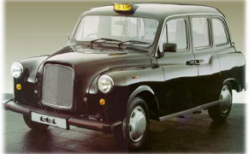
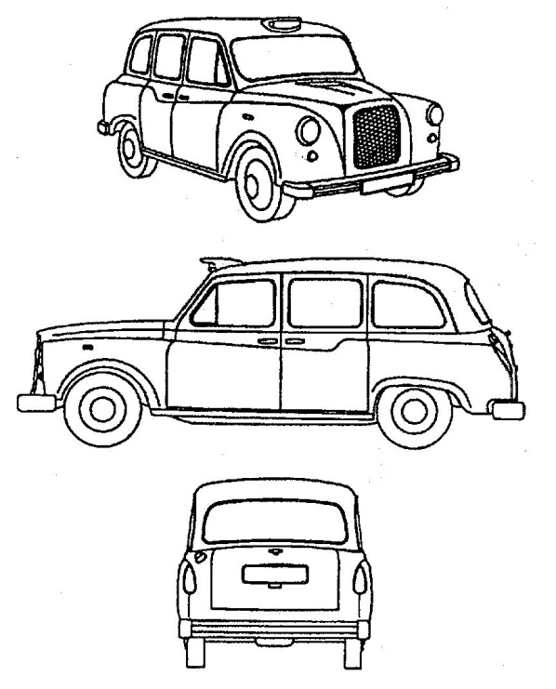
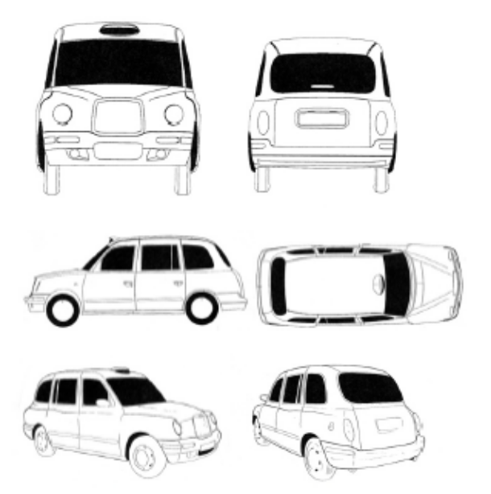
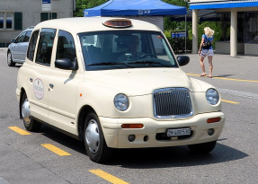
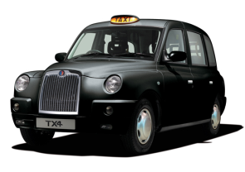
LTC’s Taxis LTC’s EU Mark LTC’s UK Mark

Slide 27
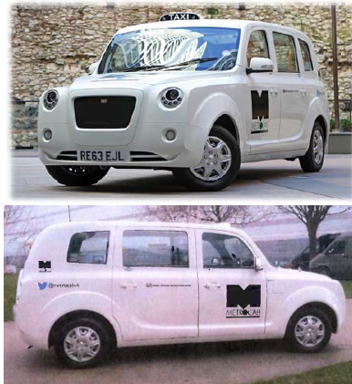
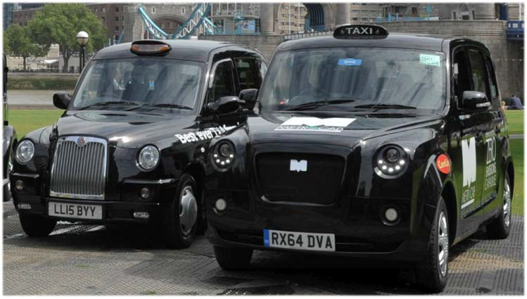
The Defendants Comparison of the two taxis
Metrocab

Slide 28
The case at issue
LTC argued that
the defendants intended to deceive the public by adopting a shape closely resembling the LTC taxis
the Metrocab would infringe LTCs registered trade marks
the defendants were passing off the Metrocab taxi as a taxi of LTC.
The defendants counterclaimed for invalidity of LTC’s trade marks.

Slide 29
Invalidity
Did the trade marks have inherent distinctive character?
Both of the trade marks were found devoid of inherent distinctive character in relation to goods in Class 12
  Different to normal cars, but they would not be perceived as anything but no more than a variation on a theme of a London Taxi.
  The average consumer would not consider the shape as designating the origin of the taxis.

Slide 30
Had the LTC trade marks acquired any distinctive character through use?
LTC has not demonstrated that the trade marks had acquired distinctive character amongst a substantial proportion of taxi drivers in the UK.
Did the shape of the taxi add substantial value?
the shape of the TX1 taxi added substantial value and should not be registerable in accordance with Article 3(1)(e)(iii) of the Trade Marks Directive.

Slide 31
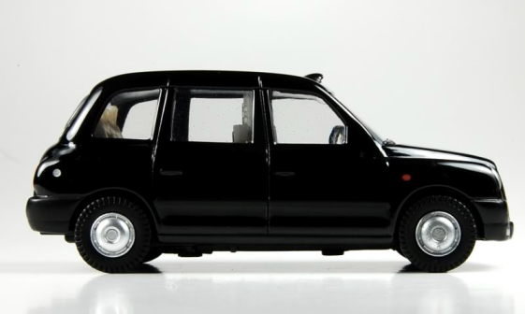
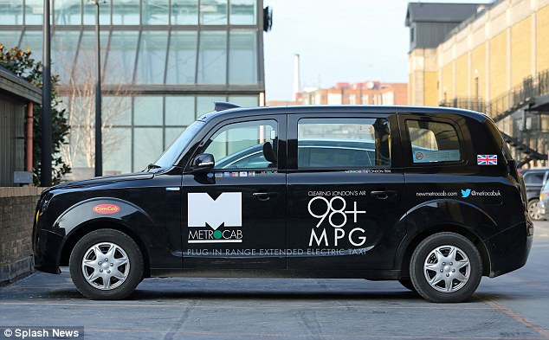
Infringement
The matter of infringement was considered as though the marks were valid and capable of being infringed.
The Metrocab had not infringed either of the LTC trade marks
The Metrocab taxis looked like a London taxi but not that similar to the LTC registered trade marks, and as a result, the average consumer wouldn’t be confused.

Slide 32
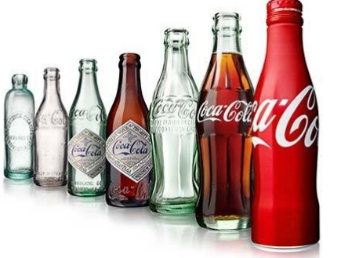
The Coca-Cola Company v EUIPO
Contour bottle history:
1916 – Birth of the Contour Bottle
1960 –The Contour Bottle with the word ‘Coca‑Cola’ written on it received its first trademark from the USPTO.
1977 – The Coca‑Cola Contour Bottle was granted a second trademark for the contour shape itself, with no words written on it.

Slide 33
Applications filed 29 December 2011
Class 6: ‘Common metals and their alloys; metal building materials; ironmongery, small items of metal hardware; goods of common metal not included in other classes; metallic bottles’;
Class 21: ‘Household or kitchen utensils and containers; unworked or semi-worked glass (except glass used in building); glassware, porcelain and earthenware not included in other classes; glass and plastic bottles’;
Class 32: ‘Beers; mineral and aerated waters and other non-alcoholic drinks; fruit drinks and fruit juices; syrups and other preparations for making beverages’.
Application refused on the grounds of a lack of distinctive character for the majority of goods applied for.

Slide 34
Coca Cola replied to objection with evidence to prove acquired distinctiveness.
The examiner dismissed the application for registration.
Coca Cola filed a notice of appeal with the EUIPO
  The Second Board of Appeal dismissed the appeal; the mark applied for was devoid of distinctive character.
  The features displayed by the container did not render the mark applied for distinctive .
  Mark was common to the shapes of the contested goods in Classes 6 and 21 and to the packaging of the contested goods in Class 32.

Slide 35
The Survey Evidence
The Board of Appeal expressed serious doubts as to the reliability of the surveys submitted.
They had not been carried out by the recognised market research company, but rather by a former director of that company who had become an independent market research consultant.
  The surveys contained leading questions and that the percentage figures did not add up correctly.
  The surveys had been carried out in less than half the Member States of the European Union.
  The surveys had been conducted after the application date.

Slide 36
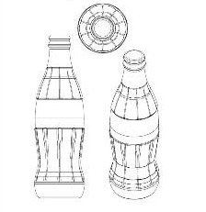
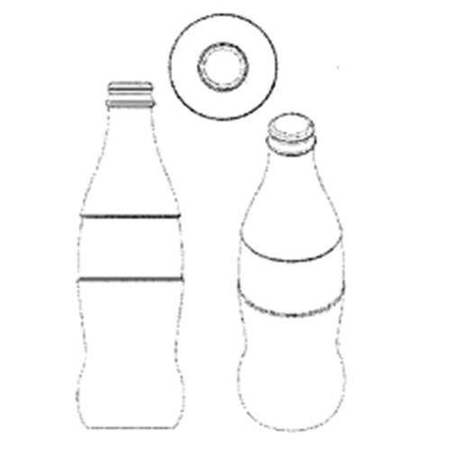
Registered
Contour bottle with fluting
Not registered
Contour bottle without fluting
[A] particular appearance which, taking into account also of the overall aesthetic result, is eye-catching and capable of holding the attention of the public concerned [and] depart[ed] significantly from the norm(s) of the sector(s).
A mere variant of the shape and packaging of [the bottle with fluting] which will not enable the average consumer to distinguish the goods in question from those of other undertakings”.

Slide 37
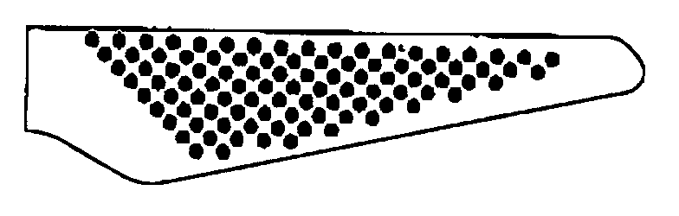
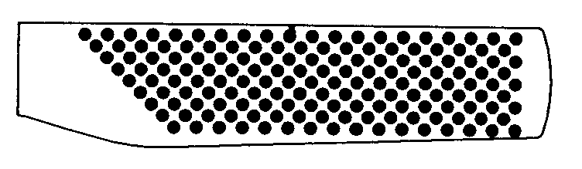
Yoshida Metal Industry Co. Ltd
Two Application's filed in November 1999, registered in 2002/2003
8 Cutlery, scissors, knives, forks, spoons, whetstones, whetstone holders, knife steels, fish bone tweezers.
21 Household or kitchen utensils and containers (not of precious metal or coated therewith), turners, spatulas for kitchen use, knife blocks for holding knives, tart scoops, pie scoops.

Slide 38
Pi-Design and Bodum applied to invalidate Yoshida's registration of an array of dots appearing on the handles of knives on the basis that they were a shape necessary to obtain a technical result
Yoshida successfully argued that the marks were valid at the cancellation division but overturned at appeal.
  Concluded that the concave dents represented on the handle were necessary to obtain the technical result of preventing the knives from slipping in the users’ hand.
Assessment can take into account material such as surveys or expert opinions or other intellectual property rights, such as patents!

Slide 39
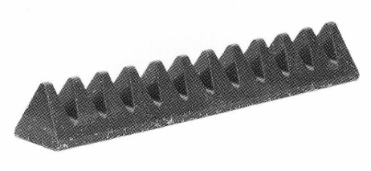
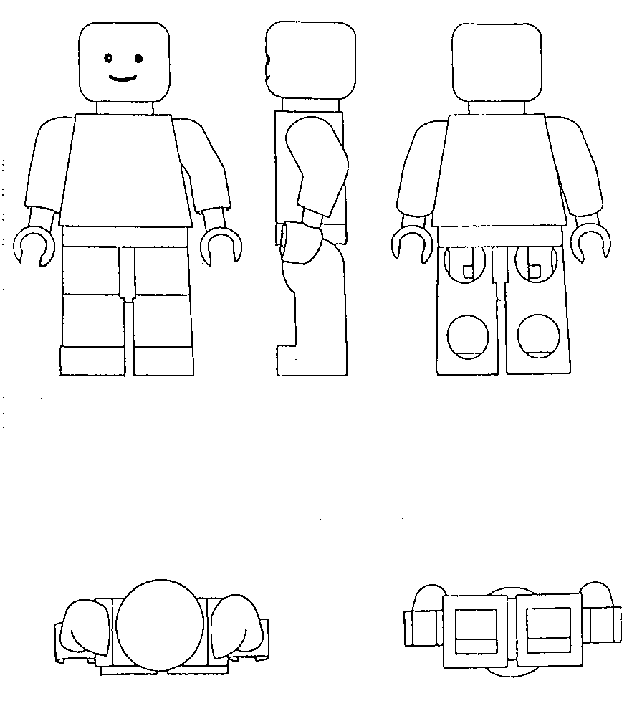
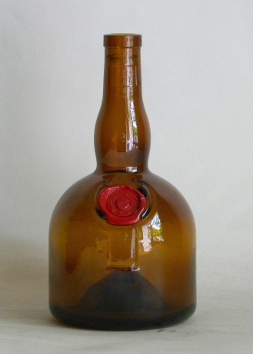
Kraft Foods Schweiz Holding GmbH
30 Chocolate, chocolate products, cocoa, confectionery and pastry, edible ices.
Registered
LEGO Juris A/S
9 Magnets (Decorative -); Computer games programs; Downloadable computer games; Recorded data carriers.
25 Clothing, footwear, headgear.
28 Games and playthings.
Registered
SOCIETE DES PRODUITS MARNIER-LAPOSTOLLE
33 Alcoholic beverages (except beers). Wines, sparkling wines, ciders, spirits and brandies, liqueurs and spirits.
Refused

Slide 40
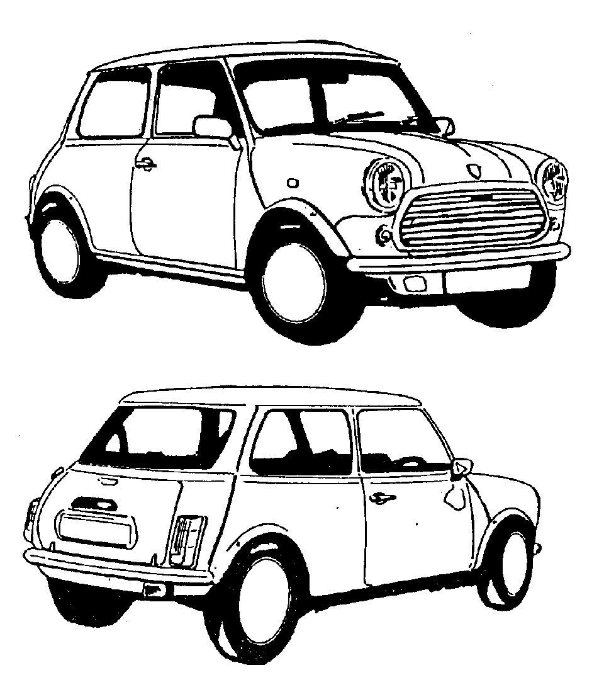
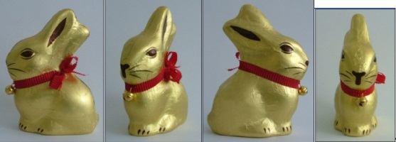
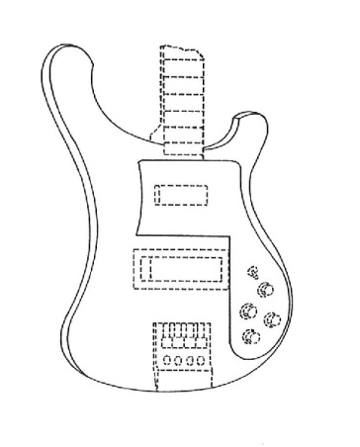
Bayerische Motoren Werke Aktiengesellschaft
12 Automobiles.
28 Toy model and scale model automobiles.
Registered
Chocoladefabriken Lindt & Sprüngli AG
30 Schokolade, Schokoladewaren.
Not registered – appeal pending
Rickenbacker International Corporation
15 Guitars; electric guitars.
Registered

Slide 41
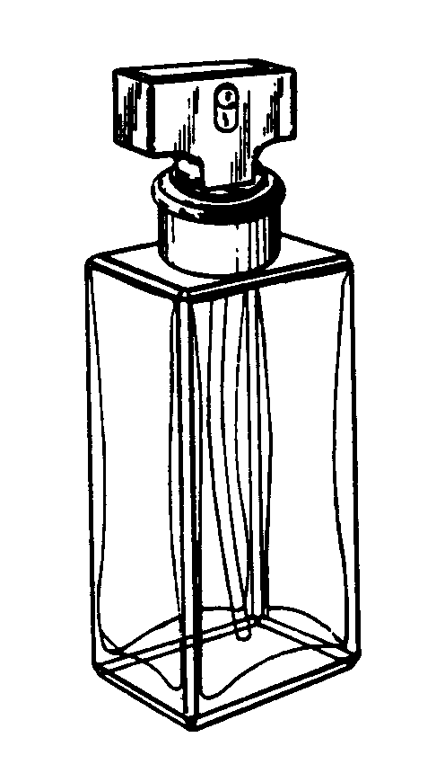
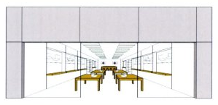
Calvin Klein Cosmetic Corporation
3 Cosmetics and toiletries, namely, eau de parfum.
Refused
Apple Inc.
35 Retail store services featuring computers, computer software, computer peripherals, mobile phones, consumer electronics and related accessories, and demonstration of products relating thereto.
Registered

Slide 42
Thank You!
Clare Cornell
Finnegan Europe
clare.cornell@finnegan.com

Slide 43
For more information please contact:
Chartered Institute of Patent Attorneys
95 Chancery Lane, London WC2A 1DT
Telephone: +44 (0) 207 405 9450
Email: info@cipa.org.uk
www.cipa.org.uk
IN ASSOCIATION WITH

